Slide 1
Digital Image Processing
Lecture 12: Color Image Processing

Slide 2
Color Image Processing
The use of color Image Processing is motivated by two principal factors:
  Color is a powerful descriptor
  Humans can distinguish between thousands of color shades and intensities compared to about only two dozen shades of gray

Slide 3
Full Color Processing vs Pseudo-Color Processing
In Full Color Processing the image in question typically are acquired with a Full-Color sensor e.g. Color TV camera or Color Scanner
In Pseudo-color Processing the problem is of assigning a color to a particular monochrome intensity or a range of intensities

Slide 4
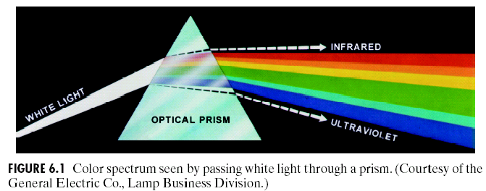
Color Spectrum

Slide 5
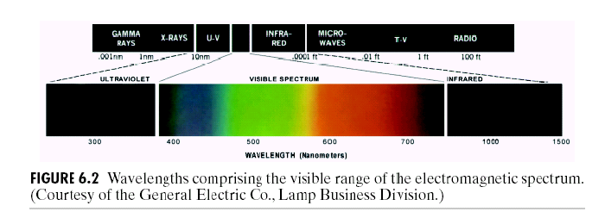
Electromagnetic Spectrum

Slide 6
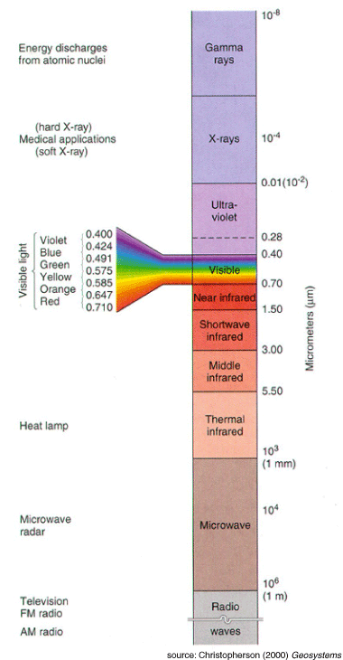
Physical Background
Visible light: a narrow band of electromagnetic radiation →
380nm (blue) − 780nm (red)
Wavelength: Each physically distinct colour corresponds to at least one wavelength in this band.
Pure Colours: Pure or monochromatic colours do not exist in nature.

Slide 7
Color Fundamentals
The colors that humans and some animals perceive in an object are determined by the nature of light reflected from the object
Characterization of light is central to the science of color

Slide 8
Achromatic vs Chromatic Light
Achromatic (void of color) Light: Its only contribute is its ‘Intensity’ or amount
Chromatic Light: spans the electromagnetic spectrum from approximately 400 to 700nm

Slide 9
Quantities for description of Chromatic Source of Light
Three basic quantities are used to describe the quantity of a chromatic source of light:
  Radiance
  Luminance
  Brightness

Slide 10
Radiance
The total amount of Energy that flows from a Light Source
It is measured in Watts

Slide 11
Luminance
Luminance gives a measure of amount of energy an observer perceives from a light source (measured in Lumens(lm) )
For example light emitted from a source operating in Infrared region of Spectrum could have significant energy (Radiance) but a human observer will hardly perceive it so luminance is zero.

Slide 12
Brightness
It is a subjective measure
It embodies the achromatic notion of intensity and is one of the key factors is describing color sensation

Slide 13
Human Perception
Detailed experimental evidences has established that the 6 to 7 million cones in the human eye can be divided into three principal sensing categories, corresponding roughly to red, green and blue
Approximately 65% of all cones are sensitive to Red Light, 33% are sensitive to Green Light and about 2% are sensitive to Blue Light (most sensitive)

Slide 14
Human Perception
Due to these absorption characteristic of Human Eye colors are seen as variable combinations of the so-called ‘Primary Colors’ Red, Green and Blue
The primary colors can be added to produce secondary colors of Light
  Magenta (Red+Blue)
  Cyan (Green+Blue)
  Yellow (Red+Green)

Slide 15
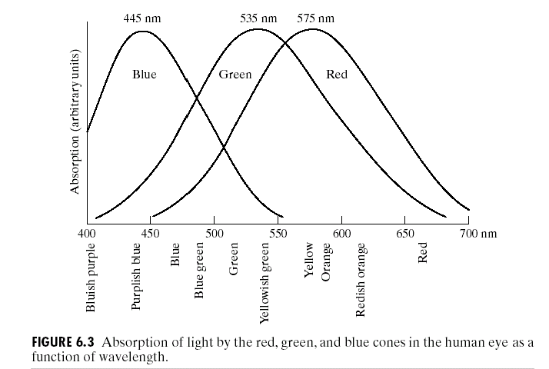
Absorption of Light by red, green and blue cones in Human Eye
No Clear Cut Boundaries
Mixing the three primaries or a secondary with its opposite primary colors in the right intensities produces white light

Slide 16
CIE Specific Wavelength
Red 700nm
Green 546.1nm
Blue 435.8 nm
CIE: International Commission on Illunmiation

Slide 17
Primary Color of Light vs Primary Color of Pigments
Red, Green and Blue Colors are Primary Colors of Light
In Primary Color of Pigments a primary color is defined as the one that subtracts or absorbs a primary color of Light and reflects or transmits the other two
Therefore the Primary Colors of Pigments are Magenta, Cyan and Yellow and secondary colors are Red, Green and Blue
A proper combination of three pigment primaries or a secondary with its opposite primary produces Black
Color Television Reception is an example of the additive nature of Light Colors

Slide 18
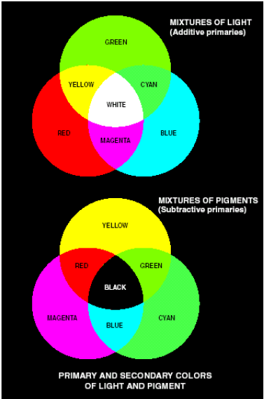
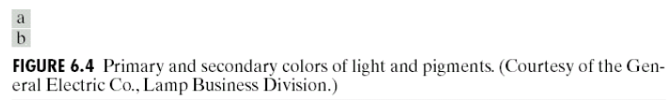

Slide 19
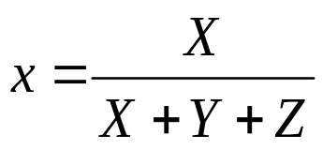

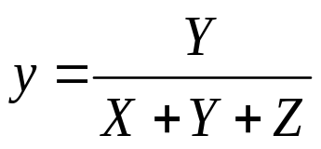
Tri-Stimulus Values
The amount of Red, Green and Blue needed to form a particular color (denoted by X, Y and Z)
A color is then specified by its “Tri-chromatic Coefficients”
Thus x+y+z=1

Slide 20
Chromaticity Diagram
Shows color compositions as a function of x(red) and y(green)
For any x and y the corresponding value of z(blue) can be obtained as
      z=1-x-y

Slide 21
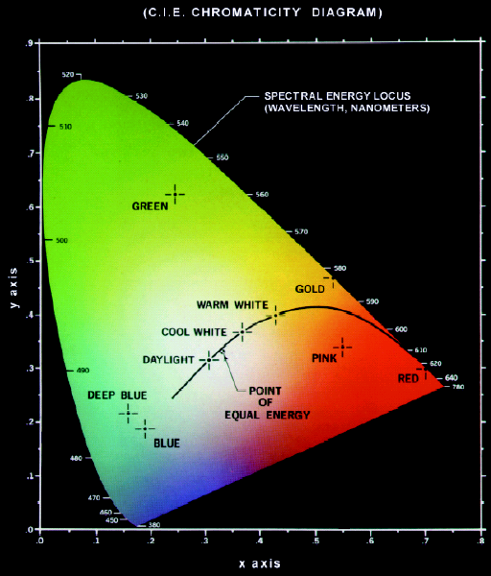
Chromaticity Diagram
Notes:
All spectarl colors are represnted along the boundaries
Point of equal energy means all components are mixed in equal energy (WHITE IN CIE)
All along the boundaries are fully saturated
Color Mixing:

Slide 22
Chromaticity Diagram-Color Mixing
Color Mixing along a line
Line from pure color to point of equal energy has all shades of that color
Notes:
All spectarl colors are represnted along the boundaries
Point of equal energy means all components are mixed in equal energy (WHITE IN CIE)
All along the boundaries are fully saturated
Color Mixing:

Slide 23
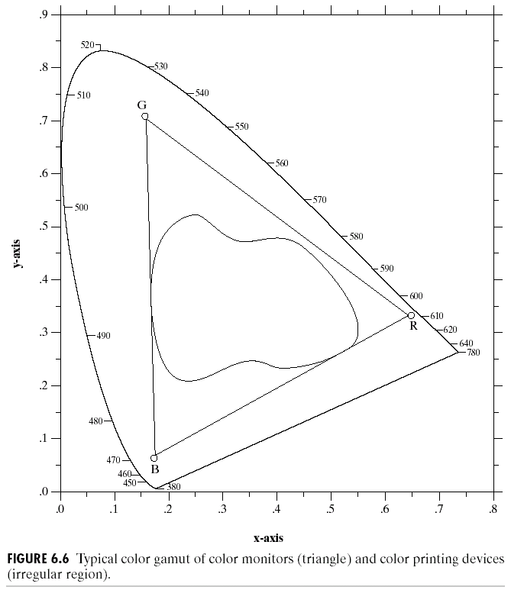
Chromaticity Diagram

